Slide 1
Introductory Programming and Problem-Solving Skills
Data Structures
Week - 5
Basanta Singh

Slide 2
Navigation Let’s Recap
Let’s Recap
Membership Operator
Iterative Control
Definite and Indefinite Loops
While Loop
For Loop
Break and Continue
Range Function

Slide 3
Navigation Multiple Values
Something From Past
Python Variables:
01
Most of the computer program holds temporary values in named storage locations
Programmers name them for easy access and reusability
But What if We Want To Store Multiple values?
In order to store multiple items in a single variable there are 4 built-in data types in python. Lists, Tuple, Dictionary and Set. All of the data-types do have their own usage and different quality.

Slide 4
Navigation Learning Outcomes
Learning Objectives
To understand the concept of lists and their application in Python.
To understand how for and while loops can be used for processing lists
To understand some of the ways in which lists can be manipulated.
To understand the concept of an associative data structure
Be able to define and use dictionaries in Python
Be able to write Python programs using dictionaries
01

Slide 5

Linear Data Structures

Slide 6
Navigation Introduction
Introduction
The way that data is organized has a significant impact on how effectively it can be used. One of the most obvious and useful ways to organize data is as list. We use list in our everyday lives – we make shopping lists, to-do lists, and mental checklists.
01
Various forms of lists are provided by programming languages, different in the elements they can store (mixed type?), their size (variable size?), weather they can be altered (mutable?), and the operation that can be performed.
In this lecture, we will look at the use of list and other sequences in Python.

Slide 7
Lists
List
Creating an empty list or new list
Adding an element to list
Listing the element of a list
List processing
Methods used with lists

Slide 8
INTRODUCTION
Like a String, list also is sequence data type. It is a data structure
It is an ordered set of values enclosed in square brackets [ ].
Values in the list can be modified –mutable.
As it is set of values, we can use index in square brackets [ ] to identify a value belonging to it.
The values that make up a list are called its elements, and they can be of any type.
Each value has a location (an index)
Lists are heterogeneous - values can be of any type (strings are homogeneous because their elements are characters)
‹#›

Slide 9
Navigation Introduction List Structure
List Structure
The concept of a list is similar to our everyday notion of list. We read off (access) items on our to-do lists, add items, cross off (delete) items and so forth.
01
List [Definition]: A list is linear data structure, meaning that its element have a linear ordering.
An example of a list is a sequence of daily temperature is given for a week.

Slide 10
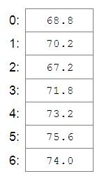
Navigation Introduction List Structure List Visualization
Let’s Visualize
[Example]: The location at 0 index stores the temperature for Sunday, the location at 1 index stores the temperature for Monday an so on.
01
It is the customary in programming languages to begin numbering sequences of items with an index value of 0 rather than 1
This is referred to as zero-based indexing.

Slide 11
Navigation Introduction List Structure 2.1. Common List Operations
Common List Operations
While maintaining a list of temperature throughout the week, can we perform such operations?
What is the temperature in Thursday?
Can we update the temperature?
Can we append more data in list?
Can we remove any data from the list?
Some of the commonly performed operations on lists include access(retrieve), update, append, insert, delete and so on.

Slide 12
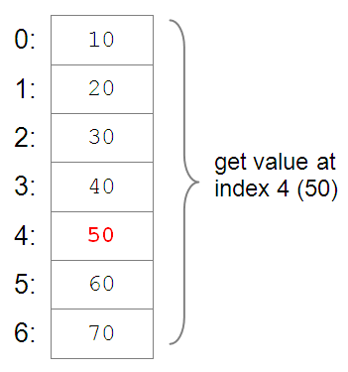
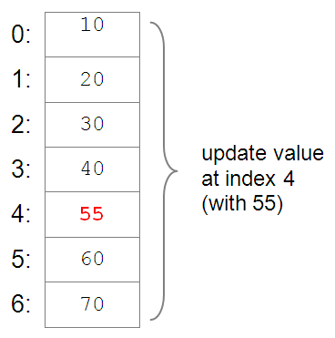
Navigation Introduction List Structure 2.1. Common List Operations 2.2. List Access and Update
Accessing and Updating

Slide 13
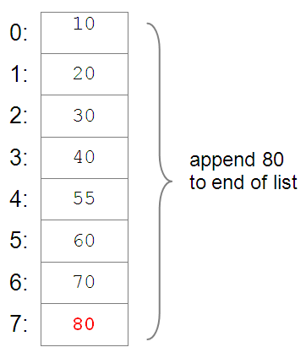
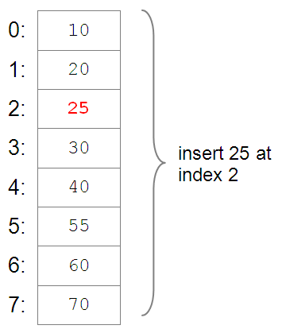
Navigation Introduction List Structure 2.1. Common List Operations 2.2. List Access and Update 2.3. Appending and Inserting
Appending and Inserting

Slide 14
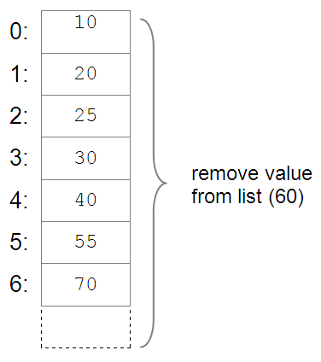
Navigation Introduction List Structure 2.1. Common List Operations 2.2. List Access and Update 2.3. Appending and Inserting 2.4. Removing from List
Removing

Slide 15

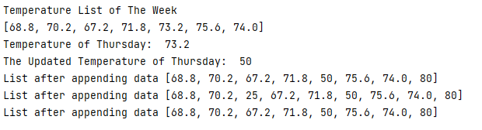
Navigation Introduction List Structure 2.1. Common List Operations 2.2. List Access and Update 2.3. Appending and Inserting 2.4. Removing from List Sneak Peek !!
Sneak Peek!!
print("Temperature List of The Week") week_temp = [68.8, 70.2, 67.2, 71.8, 73.2, 75.6, 74.0] print(week_temp) print("Temperature of Thursday: ", week_temp[4]) week_temp[4] = 50 print("The Updated Temperature of Thursday: ", week_temp[4]) week_temp.append(80) print("List after appending data", week_temp) week_temp.insert(2,25) print("List after appending data", week_temp) week_temp.remove(25) print("List after appending data", week_temp)
Output

Slide 16
To Perform Such Various Operations We Should Be Able To Access Element One By One.

Slide 17
Navigation Introduction List Structure 2.1. Common List Operations 2.2. List Access and Update 2.3. Appending and Inserting 2.4. Removing from List 2.5. List Traversal
List Traversal
List Traversal [Definition]: A list traversal is a means of accessing, one by one, each element of a list.
01
List Traversal may be used, for example to:
Search for a particular item in a list
Add up all the elements of a list to calculate a total
Perform an operation on all of the element in a list (e.g. X*X)

Slide 18
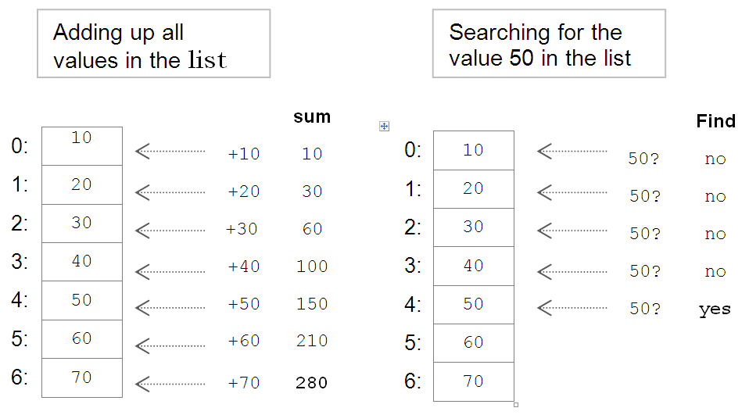
Navigation Introduction List Structure 2.1. Common List Operations 2.2. List Access and Update 2.3. Appending and Inserting 2.4. Removing from List 2.5. List Traversal 2.6. Use of List Traversal
Use of List Traversal
01

Slide 19
Navigation 2. List Structure 2.1. Common List Operations 2.2. List Access and Update 2.3. Appending and Inserting 2.4. Removing from List 2.5. List Traversal 2.6. Use of List Traversal 2.7. List in Python
List in Python
List [Definition]: A list in Python is a mutable, linear data structure of variable length, which can store mixed-type elements.
01
Mutable [Definition]: Mutable means that the contents of the list may be altered.
Lists in Python use zero-based indexing. Thus, all lists have index values 0..n-1, where n is the number of elements in the lists.

Slide 20
Navigation 2. List Structure 2.1. Common List Operations 2.2. List Access and Update 2.3. Appending and Inserting 2.4. Removing from List 2.5. List Traversal 2.6. Use of List Traversal 2.7. List in Python 2.8. List Recipe
List Recipe
List are denoted by a comma-separated list of elements within square brackets i.e. [ ],
01
[1, 2, 3] [‘one’, ‘two’, ‘three’] [‘apples’, 50, True]
Empty List [Notion]: An empty list is denoted by an empty pair of square brackets, []. Elements of list are accessed by use of an index value with in the square brackets.
lst = [1, 2, 3]
lst[0] = 1 🡪 1 Access of first element
lst[1] = 2 🡪 Access of second element
lst[2] = 3 🡪 Access of third element

Slide 21
Navigation 2. List Structure 2.1. Common List Operations 2.2. List Access and Update 2.3. Appending and Inserting 2.4. Removing from List 2.5. List Traversal 2.6. Use of List Traversal 2.7. List in Python 2.8. List Recipe Some Common Operation
Some Common Operation
For example, the following prints the first element of list lst,
print(lst[0])
The elements of lst can be summed as follows,
Update | lst[2] = 4 | Replacement of 3 with 4 at index 2
Delete | del lst[2] | Removal of 4 at index 2
Insert | lst.insert(1, 3) | Insertion of 3 at index 1
Append | lst.append(4) | Appends 4 to end of list

Slide 22
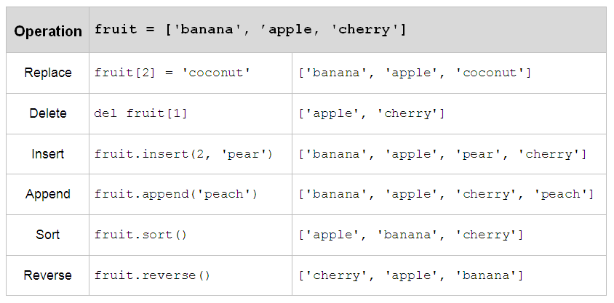
Navigation 2. 2.4. Removing from List 2.5. List Traversal 2.6. Use of List Traversal 2.7. List in Python 2.8. List Recipe 2.9. Python List Operation
Python List Operation
01
https://docs.python.org/3/tutorial/datastructures.html

Slide 23
Sam’s Car Collection!!

Slide 24
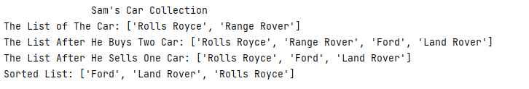
Navigation 2. 2.4. Removing from List 2.5. List Traversal 2.6. Use of List Traversal 2.7. List in Python 2.8. List Recipe 2.9. Python List Operation
Let’s Understand Through Example
print(f"Sam's Car Collection".center(50)) car = ["Rolls Royce", "Range Rover"] print("The List of The Car:", car) car.append("Ford") car.append("Land Rover") print("The List After He Buys Two Car:",car) car.remove("Range Rover") print("The List After He Sells One Car:", car) car.sort() print("Sorted List:", car)
Here, we can see that different cars are kept in a list and various operations such as appending, removing and sorting are performed in that list.
01
Output

Slide 25
Tuples

Slide 26
Navigation Introduction Lists Tuples
Tuples
Tuple [Definition]: A tuple is an immutable linear data structure. Thus, in contrast to lists, once a tuple is defined it cannot be altered. Otherwise, tuples and lists are essentially the same.
01
To distinguish tuples from lists, tuples are denoted by parenthesis instead of square brackets:
nums = (10, 20, 30)
student = (‘John Smith’, 48, ‘Computer Science’, 3.42)
Another difference of tuples and list is that tuples of one element must include a comma and following the element. Otherwise the parenthesized will not be made into a tuple:
num = (10,)

Slide 27
Navigation Introduction Lists 3. Tuples 3.1. Access Tuple
How To Access Tuple?
Tuple [Notion]: An empty tuple is represented by a set of empty parenthesis, ().
The elements of tuples are accessed the same as lists, with square brackets.
nums = (10, 20, 30)
student = (‘John Smith’, 48, ‘Computer Science’, 3.42)
>>> num [0] >>>students [0]
10 ‘John Smith’
Any attempt to alter a tuple is invalid. Thus, delete, update, insert and append operations are not defined on tuples

Slide 28
Navigation Introduction Lists 3. Tuples 3.1. Access Tuple 3.2. Sequences in python
Sequences in python
There are various sequences in python.
01
Sequences: A sequences in Python is a linearly-ordered set of elements accessed by index number.
List, tuples and string are all sequences
Strings, tuples are immutable, therefore they cannot be altered.
You might be wondering then, what happens when we ‘modify’ a String

Slide 29

Operation |  | String s = 'hello' w = '!' | Tuple s = (1, 2, 3, 4) w = (5, 6) | List s = [1, 2, 3, 4] w = [5, 6]
Length | len(s) | 5 | 4 | 4
Select | s[0] | 'h' | 1 | 1
Slice | s[1:4] s[1:] | 'ell' 'ello' | (2, 3, 4) (2, 3, 4) | [2, 3, 4] [2, 3, 4]
Count | s.count('e') s.count(4) | 1 -- | -- 1 | -- 1
Index | s.index('e') s.index(3) | 1 -- | -- 2 | -- 2
Membership | 'h' in s | True | False | False
Concatenation | s + w | 'hello!' | (1, 2, 3, 4, 5, 6) | [1, 2, 3, 4, 5, 6]
Minimum | min(s) | 'e' | 1 | 1
Maximum | max(s) | 'o' | 4 | 4
Sum | sum(s) | n/a | 10 | 10
01

Slide 30

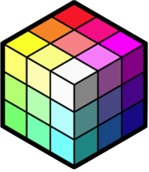
Navigation Introduction Lists 3. Tuples 3.1. Access Tuple 3.2. Sequences in python 3.3. Nested Lists
Nested Lists
Lists and tuples can contain elements of any type, including other sequences.
01
Thus, lists and tuples can be nested to create arbitrarily complex data structures
This can be useful for representing data points identified by two or more dimensions (eg. Table of values)

Slide 31
Navigation Introduction Lists 3. Tuples 3.1. Access Tuple 3.2. Sequences in python 3.3. Nested Lists continued
Nested Lists
class_grades = [[85, 91, 89], [78, 81, 86], [62, 75, 77], ..]
The list stores three exam grades for each student.
class_grades[0] equals [85, 91, 89]
class_grades[1] equals [78, 81, 86]
To access the first exam grade of the first student in the list,
student1_grades = class_grades[0] 🡪 [85, 91, 89]
student1_exam1 = student1_grades[0] 🡪 85
OR
class_grades [0][0] 🡪 85

Slide 32
Average of exam 1
class_grades = [[85, 91, 89], [78, 81, 86], [62, 75, 77]]

Slide 33
Navigation Introduction Lists 3. Tuples 3.1. Access Tuple 3.2. Sequences in python 3.3. Nested Lists Example 1
Let’s Understand Through Example
There are two ways through which you can access to a nested lists.
Accessing without iteration.
Accessing with iteration.
01
You need to identify when to use when as per the requirement.
class_grades = [[85, 91, 89], [78, 81, 86], [62, 75, 77]] sum = class_grades[0][0] + class_grades[1][0] + class_grades[2][0] average = sum/float(len(class_grades)) print(average)

Slide 34
Navigation Introduction Lists 3. Tuples 3.1. Access Tuple 3.2. Sequences in python 3.3. Nested Lists Example 2
Let’s Understand Through Example
k = 0 sum = 0 class_grades = [[85, 91, 89], [78, 81, 86], [62, 75, 77],[62, 75, 77]] while k < len(class_grades): sum = sum + class_grades[k][0] k +=1 avergae = sum/float(len(class_grades)) print(avergae)
01
Here, we can see that list is being accessed through the iteration. Since the value of k is initialised as 0, in first iteration, class_grades[0][0] will be 85 and through each iteration value of k is increased by 1
len(class_grades) will prompt to find the length of the class grade list which is 4

Slide 35
Can we calculate and store the average marks of each student to a new list?

Slide 36
Navigation Introduction Lists 3. Tuples 3.1. Access Tuple 3.2. Sequences in python 3.3. Nested Lists Example 3
Let’s Understand Through Example
k = 0 exam_average = [] class_grades = [[85, 91, 89], [78, 81, 86], [62, 75, 77]] while k < len(class_grades): sum = class_grades[k][0] + class_grades[k][1] + class_grades[k][2] k+=1 average = sum/3.0 exam_average.append(average) print(exam_average)
01
Here, we can see that, an empty list is initialised in order to append the average marks of each students in all the modules. In future, while this is a much essential concept.

Slide 37
Iterating Over a List.

Slide 38
Navigation Introduction Lists 3. Tuples 3.1. Access Tuple 3.2. Sequences in python 3.3. Nested Lists 4. Iteration over Lists
Iterating over Lists (Sequence)
As we discussed last week, iteration is used in various concept of programming.
01
Python for statement provides a convenient means of iterating over lists (and other sequences).
for statement [Definition]: A for statement is an iterative control statement that iterates once for each element in a specified sequence of elements.
For loops are used to construct definite loops.

Slide 39
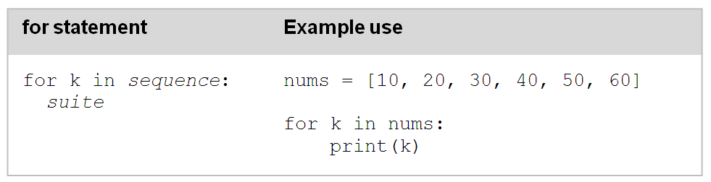
Navigation 3. Tuples 3.1. Access Tuple 3.2. Sequences in python 3.3. Nested Lists 4. Iteration over Lists For statement in Sequence
For Statements in Sequence
01
Variable k is referred to as a loop variable. Since there are six elements in the provided list, the for loop iterates exactly six times.

Slide 40
Navigation Introduction Lists 3. Tuples 3.1. Access Tuple 3.2. Sequences in python 3.3. Nested Lists 4. Iteration over Lists 4.1. For vs. while statements
(For vs. While) Statements
To contrast the use of for loops and while loops for list iteration, the same iteration is provided as a while loop below:
01
k = 0 while k < len(nums): for k in nums: print (nums[k]) print(k) k = k + 1
In the while loop version, loop variable k must be initialized to 0 and incremented (by 1) each time through the loop. In the for loop version, however, loop variable k automatically iterates over the provided sequence of values making the syntax much more succinct.

Slide 41
Navigation Introduction Lists 3. Tuples 3.1. Access Tuple 3.2. Sequences in python 3.3. Nested Lists 4. Iteration over Lists 4.1. For vs. while statements 4.2. For statement for all sequences
For statement for all sequences
The for statement can be applied to all sequences types including strings.
01
for ch in 'Hello': print(ch)
Explanation
for: for is the keyword to execute for statement
ch: ch is a loop variable (can be any sensible identifier) where value during iteration is stored
in: a membership operator which determines weather there is value or not.
H e l l o
Output

Slide 42
Navigation Introduction Lists 3. Tuples 4. Iteration over Lists 4.1. For vs. while statements 4.2. For statement for all sequences 4.2. Built-in range function
The Built-In range Function
As we discussed, python provides built-in range function that can be used for generating a sequence of integers that a for loop can iterate over:
01
sum = 0
for k in range (1, 11):
sum = sum + k
The value in the generated sequence include the starting value, up to but not including the ending value.
For Instance [Example]: range(1,11) generates the sequence [1,2,3,4,5,6,7,8,9,10]. Thus, this for loop adds up the integer value 1-10

Slide 43
Navigation Introduction Lists 3. Tuples 4. Iteration over Lists 4.1. For vs. while statements 4.2. For statement for all sequences 4.2. Built-In Range Function 4.3. Why to Use Range Function?
Why To Use Range Function?
The range function is convenient when long sequences of integers are needed.
01
Actually, range does not create a sequence of integers. It creates a generator function able to produce each next time of the sequence.
This saves memory, especially for long lists. Therefore, typing range (0,9) in the Python shell does not produce a list as expected – it simply “echoes out” the call to range.

Slide 44
Navigation Introduction Lists 3. Tuples 4. Iteration over Lists 4.1. For vs. while statements 4.2. For statement for all sequences 4.2. Built-in range function 4.3. Range function parameters
Start, Stop and Step
By default, the range function generates a sequence of consecutive integers.
01
A “step” value can be provided.
range(0, 11, 2) 🡪 [0,2,4,6,8,10] 🡪 containing a step value of 2
range(10, 0, -1) 🡪 [10, 9, 8, 7, 6, 5, 4, 3, 2, 1] 🡪 containing a step value of -1

Slide 45
Navigation Introduction Lists 3. Tuples 4. Iteration over Lists 4.1. For vs. while statements 4.2. For statement for all sequences 4.2. Built-in range function 4.3. Range function parameters 4.4. While Loops and Lists
While Loops and Lists
There are situations in which a sequence is to be traversed until a given condition is true. In such cases, a while loop is appropriate control structure.
01
Explanation: The loop continues until either the item is not found, or the complete list has been traversed. The final if statement determines which of the two possibilities of ending the loop occurred, displaying either ‘item found’ or ‘item not found’
nums = [10,20,30,40,50,60] k = 0 item_to_find = 40 found_item = False while k < len(nums) and not found_item: if nums[k] == item_to_find: found_item = True else: k = k + 1 if found_item: print("Item Found") else: print("item not found")

Slide 46
Associative Data Structures

Slide 47
Navigation Introduction Lists 3. Tuples 4. Iteration over Lists 5. Associative Data Structures
Associative Data Structures
In this section, we introduce the notion of an associative data structure.
01
Element of indexed linear data structures, such as lists, are ordered – the first element (at index 0), second element (at index 1) and so forth. In contrast, the element of an associative data structure are unordered, instead accessed by an associated key.
In Python, an associative data structure is provided by the dictionary type.

Slide 48
Dictionary

Slide 49
Navigation Introduction Lists 3. Tuples 4. Iteration over Lists 5. Associative Data Structures 5.1. What is a Dictionary?
What is a Dictionary?
A dictionary is a mutable, associative data structure of variable length.
01
It is an ordered collection (starting from Python 3.7) of items. It stores element in key/value pairs. Here, key are unique identifiers that are associate with each value. Dictionary does not allow duplicate keys.
For instance, Let’s see a data of weekly temp in dictionary
Key | Value
Sun | 18.8
Mon | 10.2
Tue | 17.2
Wed | 11.8

Slide 50
Navigation Introduction Lists 3. Tuples 4. Iteration over Lists 5. Associative Data Structures 5.1. What is a Dictionary? Dictionary Recipe
Dictionary Recipe
Dictionary daily_temps stores the average temperature for each day of the week. Each temperature has with it a unique key value (sun, mon, etc.) Strings are often used as key values.
01
daily_temp = {'sun': 18.8, 'mon': 10.2, 'tue': 17.2, 'wed': 11.8, 'thur': 13.2, 'fri': 15.6, 'sat': 14.0} print(daily_temp)
The Bracket notion of dictionary is curly braces i.e. {} and accessing to the value is same like list but there we used indexing number whereas here we use keys.

Slide 51
Navigation Introduction Lists 3. Tuples 4. Iteration over Lists 5. Associative Data Structures 5.1. What is a Dictionary? 5.2. Tuple as Key
Tuple as Key
Strings are often used as key values, however, any other immutable type may be used as well.
01
For instance:
temps = { ('Jan', 02, 2004): 14.8, ('Mar', 06, 2000): 18.2, ('Nov', 30, 2003): 11.0, ('Apr', 14, 2001): 14.6, ('Dec', 21, 2002): 18.8 }
('Apr', 14, 2001): | 14.6
('Dec', 21, 2002): | 18.8
('Nov', 30, 2003): | 11.0
('Jan', 02, 2004): | 14.8
('Mar', 06, 2000): | 18.2
Associative Data Structure Using Tuple Key Values
temps[('Apr', 14, 2001)] → 14.6

Slide 52
Some of the common operation of dictionaries

Slide 53
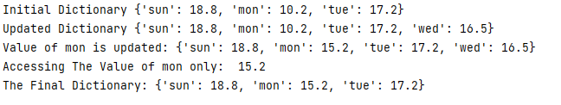
Navigation Introduction Lists 3. Tuples 4. Iteration over Lists 5. Associative Data Structures 5.1. What is a Dictionary? 5.2. Tuple as Key Sneak Peek!!
Sneak Peek!!
daily_temp = {'sun': 18.8, 'mon': 10.2, 'tue': 17.2} print("Initial Dictionary", daily_temp) daily_temp["wed"] = 16.5 print("Updated Dictionary", daily_temp) daily_temp['mon']= 15.2 print("Value of mon is updated:", daily_temp) print("Accessing The Value of mon only: ", daily_temp['mon']) del daily_temp['wed'] print("The Final Dictionary:", daily_temp)
Output

Slide 54
Navigation Introduction Lists 3. Tuples 4. Iteration over Lists 5. Associative Data Structures 5.1. What is a Dictionary? 5.2. Tuple as Key 5.3. Dictionary Operation
Dictionary Operation
Operation | Results
dict() | Creates a new, empty dictionary
dict(s) | Creates a new dictionary with key values and their associated values for sequence s, for example: fruit_prices = dict(fruit_data) where fruit_data is (possible read from a file): [['apples', '.66'], …, ['bananas', 0.49]]
len(d) | Length (num of key/value pairs) of dictionary d.
d[key] = value | Sets the associated value for key to value, used to either add a new key/value pair, or replace the value of an existing key/value pair.
del d[key] | Remove key and associated value from dictionary d.
key in d | True if key value key exists in dictionary d, otherwise returns False.
01
https://docs.python.org/3/tutorial/datastructures.html

Slide 55
Conditional statement in dictionary

Slide 56
Navigation Introduction Lists 3. Tuples 4. Iteration over Lists 5. Associative Data Structures 5.1. What is a Dictionary? 5.2. Tuple as Key 5.3. Dictionary Operation Example!!
Let’s Understand Through Example
01
daily_temp = {'sun': 18.8, 'mon': 10.2, 'tue': 17.2, 'wed': 11.8, 'thur': 13.2, 'fri': 15.6, 'sat': 14.0}
if daily_temp['sun'] < daily_temp['sat']: print("Sunday was warmer weekend day") elif daily_temp['sun'] > daily_temp['sat']: print("Sunday was warmer weekend day") else: print('Saturday and Sunday were equally warm')

Slide 57
Navigation Introduction Lists 3. Tuples 4. Iteration over Lists 5. Associative Data Structures 5.1. What is a Dictionary? 5.2. Tuple as Key 5.3. Dictionary Operation Try Outs!!
Let’s Try
From the Python Shell, enter the following and observe the results.
>>> fruit_prices = { 'apples': '.66', 'pears': '.25', 'peaches': '.74', 'bananas': '.49' } >>> fruit_prices['apples’] ??? >>> fruit_prices[0] ??? >>> veg_data = [['corn', '.25'], ['tomatoes', '.49'], ['peas', '.39']] >>> veg_prices = dict(veg_data) >>> veg_prices ??? >>> veg_prices['peas'] ???
01

Slide 58
Iterating over Dictionaries in Python

Slide 59
Navigation Introduction Lists 3. Tuples 4. Iteration over Lists 5. Associative Data Structures 5.1. What is a Dictionary? 5.2. Tuple as Key 5.3. Dictionary Operation 5.4. Iteration over Dictionaries
Iteration over Dictionaries
We can iterate over the keys and values of a dictionary as we would with any other sequence. The easiest way is to use for loop.
01
There are various built-in functions which can be use to help us iterate over dictionaries in Python which are dict.keys(), dict.values() and dict.items()

Slide 60
Navigation Introduction Lists 3. Tuples 4. Iteration over Lists 5. Associative Data Structures 5.1. What is a Dictionary? 5.2. Tuple as Key 5.3. Dictionary Operation 5.4. Iteration over Dictionaries 5.5. Iteration over key
Iteration over key or value
If you just need to work with keys of a dictionary, then you can use .keys(), which is a method that returns a new view object contacting the dictionary keys:
01
colours = {'spade': 'red', 'bucket': 'blue', 'towel': 'grey’}
for key in colours.keys():
print(key)
It’s also common to only use the values to iterate through a dictionary in Python. One way to do that is to use .values(), which returns a view with the values of the dictionary
colours = {'spade': 'red', 'bucket': 'blue', 'towel': 'grey’}
for key in colours.values():
print(values)

Slide 61
Navigation Introduction Lists 3. Tuples 4. Iteration over Lists 5. Associative Data Structures 5.4. Iteration over Dictionaries 5.5. Iteration over key 5.6. Iteration over Dictionaries
Iteration over Dictionaries
When you’re working with dictionaries, it’s likely that you’ll want to work with both the keys and values. One of the most useful ways to iterate through a dictionary in python is by using the built-in items() function.
This returns list of tuples, each tuple containing a key and a value. Each tuple is then unpacked to two variables to print one dictionary item at a time.
colours = {'spade': 'red', 'bucket': 'blue', 'towel': 'grey’}
for key, value in colours.items():
print(key, value)

